Slide 1
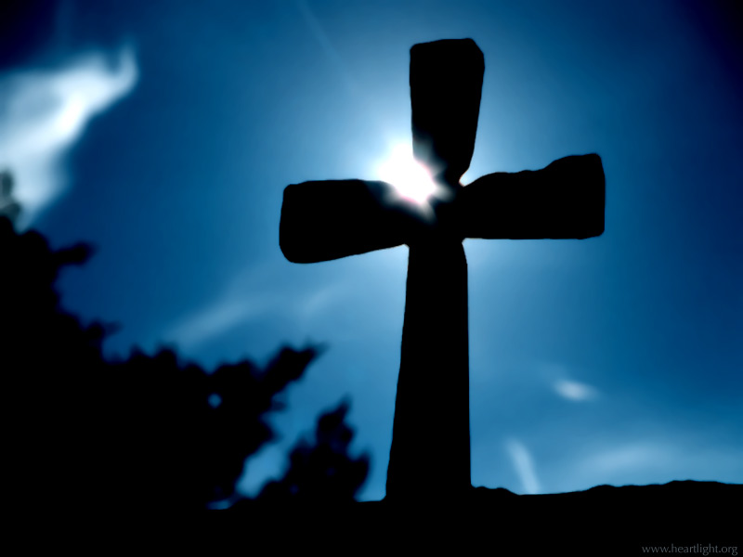
Because
We Care

Slide 2


Slide 3

We Care
What if the Lord were to come back right now?
Would you know for sure, without a doubt, that you would go to heaven?

Slide 4
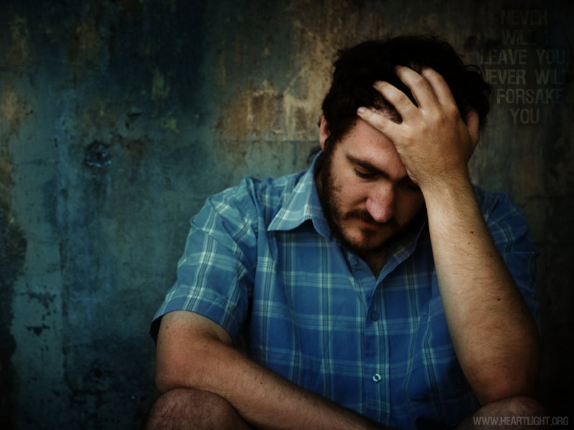
We Care
Can I really know?
Do you think you can know for sure???

Slide 5
We Care
The Bible says…
YES!!!
We can know!
I John 5:13 (pg. 362)
13 These things I have written to you who believe in the name of the Son of God, that you may know that you have eternal life, and that you may continue to believe in the name of the Son of God.

Slide 6

We Care
So, the apostle says…
To have Eternal Life…We must
believe in the Son of God
So….
Who is “The Son of God?” and what does it mean to believe in Him?

Slide 7
We Care
Matthew 16:13-17
13 When Jesus came into the region of Caesarea Philippi, He asked His disciples, saying, "Who do men say that I, the Son of Man, am?" 14 So they said, "Some say John the Baptist, some Elijah, and others Jeremiah or one of the prophets." 15 He said to them, "But who do you say that I am?" 16 Simon Peter answered and said, "You are the Christ, the Son of the living God." 17 Jesus answered and said to him, "Blessed are you, Simon Bar-Jonah, for flesh and blood has not revealed this to you, but My Father who is in heaven.

Slide 8
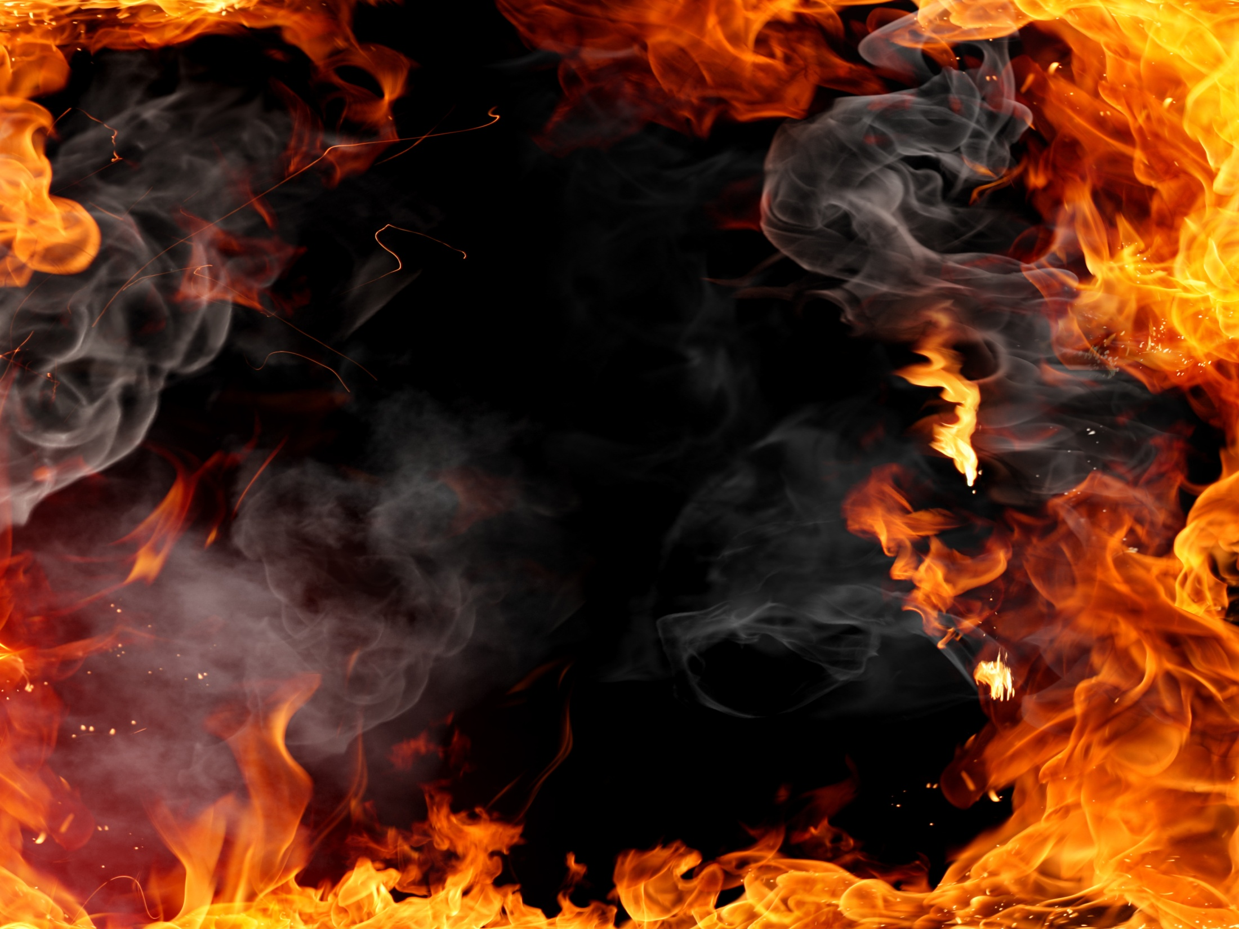
We Care
John 8:24
24 Therefore I said to you that you will die in your sins; for if you do not believe that I am He, you will die in your sins.”
This Belief stuff and what it really means, seems pretty important doesn’t it! (more on that to come!)

Slide 9
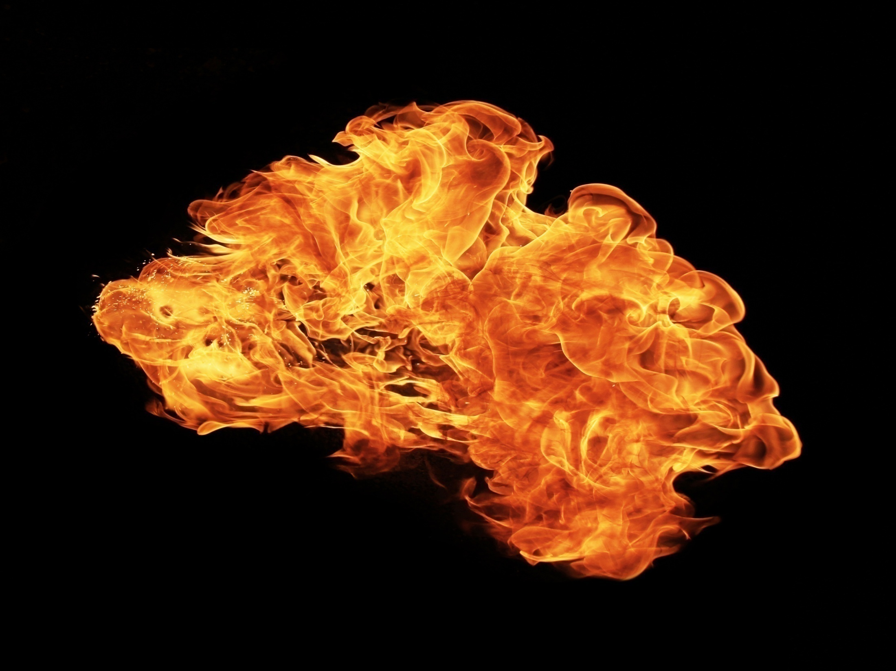
In the last verse we saw man has two problems:
          Sin
          Death

Slide 10

We Care
So Who is this Jesus we are supposed to believe in?
John 1:1 (pg. 137)
John 1:14 (pg. 138)
Colossians 2:9 (pg. 304)
Hebrews 1:8 (pg. 327)
John 8:58 (pg. 154)
Matthew 3:16-17 (pg. 4)
Word
Flesh
Godhead
God
I AM
Trinity

Slide 11
We Care
So the Bible says Jesus is…
Son of God
The Word
God in the flesh
The Godhead Bodily (God as man)
God
The Great “I AM”
Part of the Godhead

Slide 12
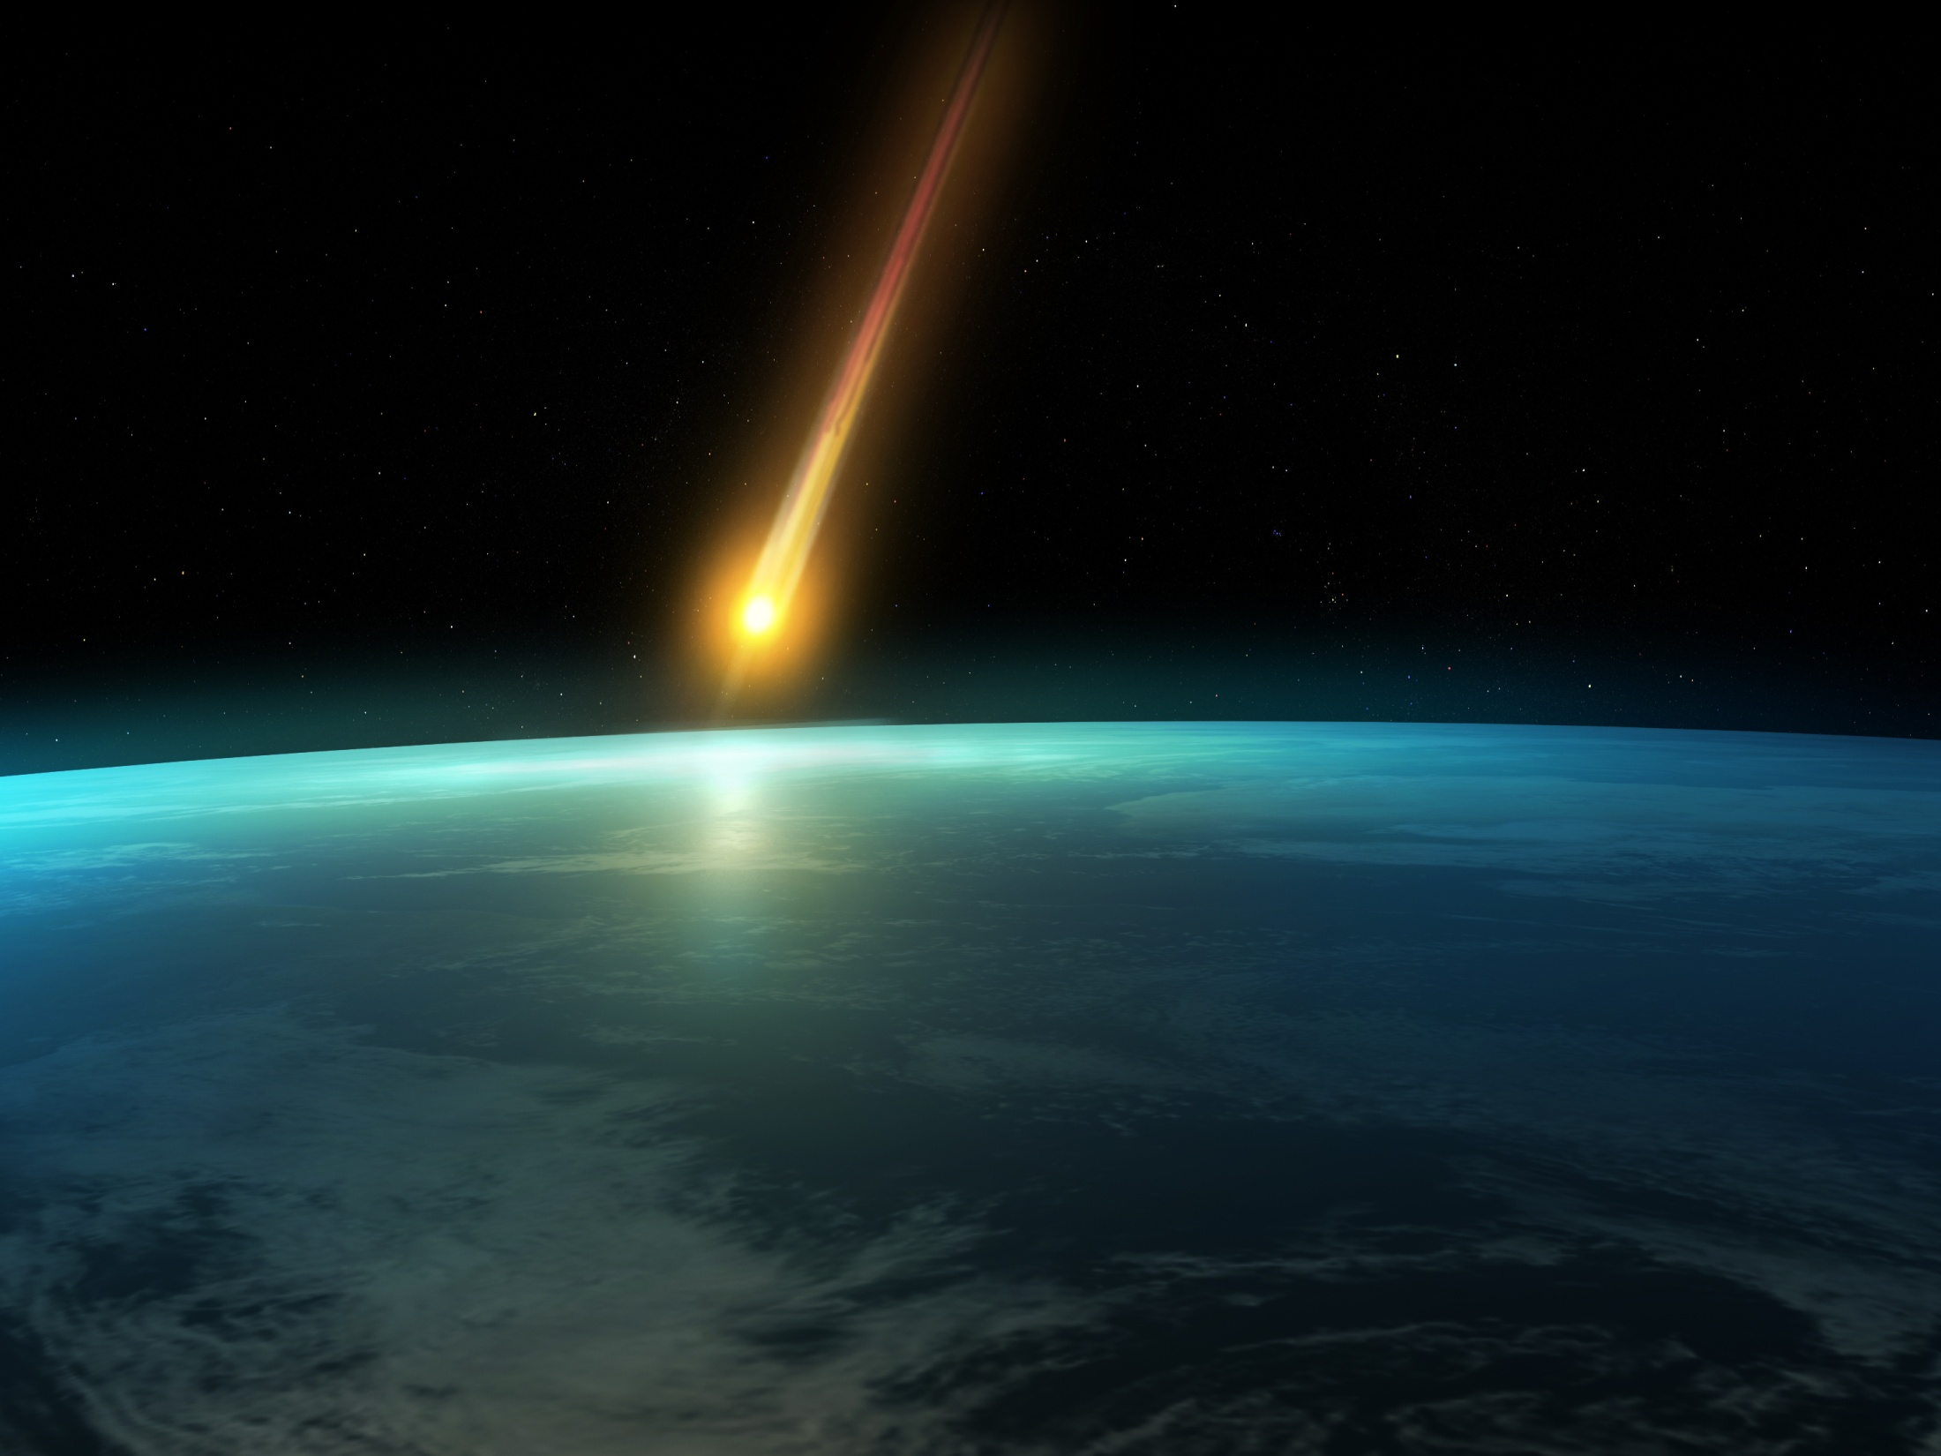
We Care
Jesus is…
100% God
and
100% Man (Flesh)
Why is that important?

Slide 13
We Care
I Timothy 2:5 (pg. 315)
5 For there is one God and
one Mediator between God and men, the Man Christ Jesus,
So why do I need
a mediator ?

Slide 14
We Care
Isaiah 59:2 (pg. 392)
2 But your iniquities have separated you from your God; And your sins have hidden His face from you, So that He will not hear.
God

Slide 15
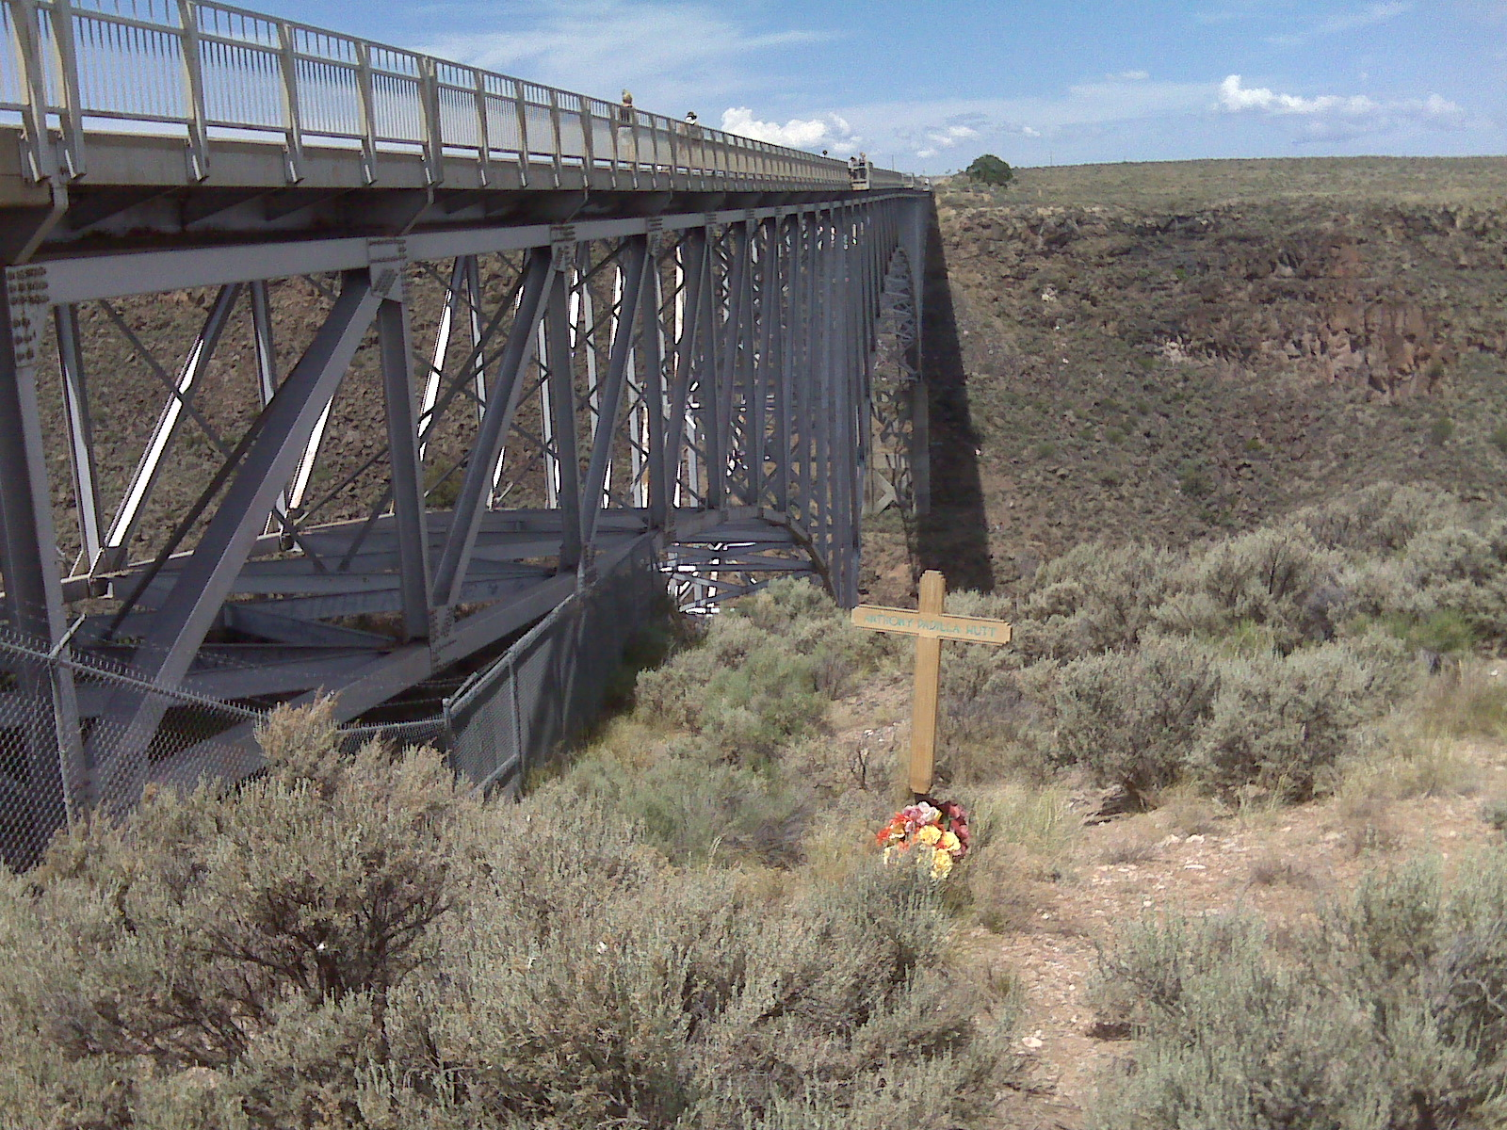
We Care
Mediator
God
Sin separates us from God
Jesus Christ
Then what can
save us?

Slide 16
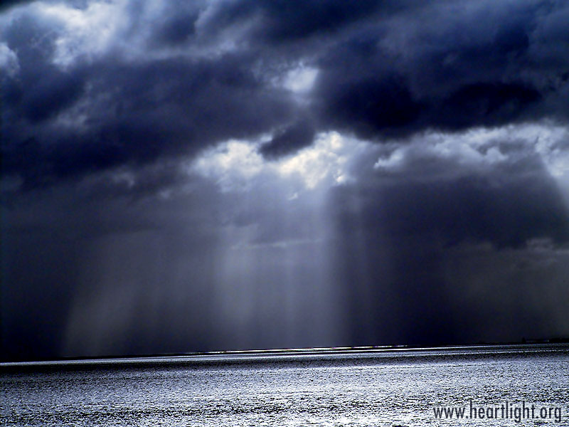
Romans 1:16 (pg. 229)
16 For I am not ashamed of the gospel of Christ, for it is the power of God to salvation for everyone who believes, for the Jew first and also for the Greek.
So What is the ‘gospel of Christ’?

Slide 17
We Care
I Corinthians 15:1-4 (pg. 267)
1 Moreover, brethren, I declare to you the gospel which I preached to you, which also you received and in which you stand, 2 by which also you are saved, if you hold fast that word which I preached to you--unless you believed in vain. 3 For I delivered to you first of all that which I also received: that Christ died for our sins according to the Scriptures, 4 and that He was buried, and that He rose again the third day according to the Scriptures,

Slide 18
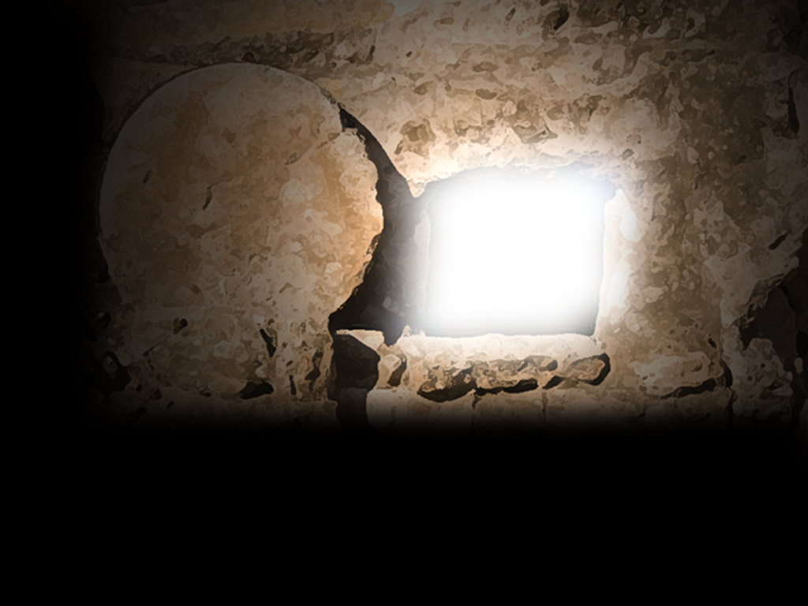
We Care
Died
Raised
The apostle Paul said the gospel is the death, burial and resurrection of Jesus Christ
Buried

Slide 19
We Care
Died
Raised
Why did Jesus have to do each of these things to save us?
Buried

Slide 20
We Care
Ephesians 1:7 (pg. 291)
7 In Him we have redemption through His blood, the forgiveness of sins, according to the riches of His grace
How wonderful is this forgiveness?

Slide 21
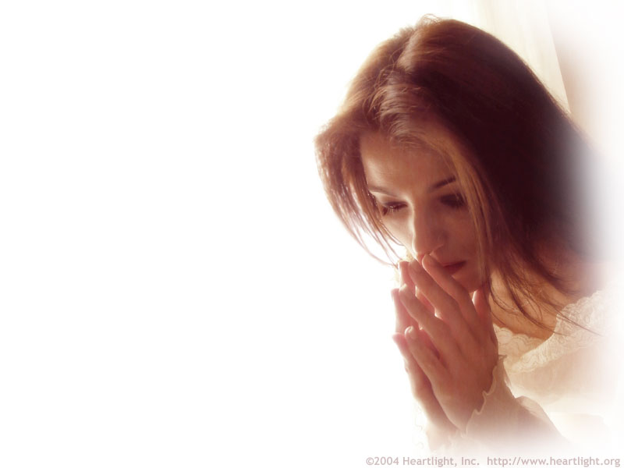
We Care
Jude 24 (pg. 366)
24 Now to Him who
is able to keep you
from stumbling, And to
present you faultless
Before the presence of
His glory with exceeding joy,

Slide 22

We Care
Jesus took care of our sin problem with His death.
So why does the gospel say He was raised for us as well?

Slide 23
We Care
I Corinthians 15:20-23 (pg. 268)
20 But now Christ is risen from the dead, and has become the firstfruits of those who have fallen asleep. 21 For since by man came death, by Man also came the resurrection of the dead. 22 For as in Adam all die, even so in Christ all shall be made alive. 23 But each one in his own order: Christ the firstfruits, afterward those who are Christ's at His coming.

Slide 24
We Care
II Timothy 1:10 (pg. 320)
10 but has now been revealed by the appearing of our Savior Jesus Christ, who has abolished death and brought life and immortality to light through the gospel,
Paul also says it another way…

Slide 25
We Care
Romans 5:10 (pg. 234)
10 For if when we were enemies we were reconciled to God through the death of His Son, much more, having been reconciled, we shall be saved by His life.
If we are reconciled to God through the death of Jesus Christ, how do we “get into Jesus’ death”?

Slide 26
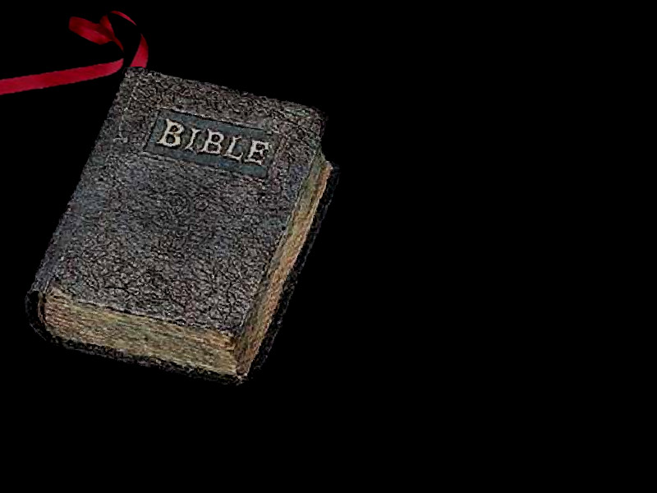
We Care
The Bible has a lot of…
“Life and Death”
statements

Slide 27
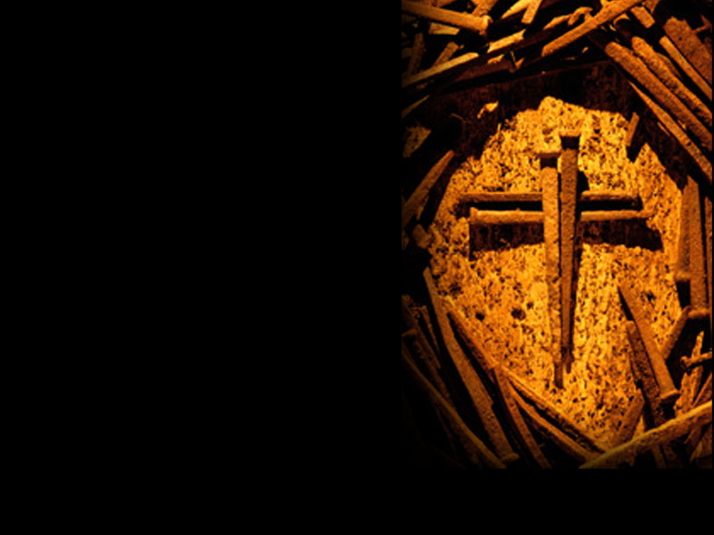
We Care
Romans 10:9 (pg. 242)
10 that if you confess
with your mouth the Lord Jesus and believe in your
Heart that God has raised Him from the dead,
you will be saved.
Must confess and
believe the gospel to be saved?

Slide 28
We Care
If we choose salvation through Christ’s gospel – will our lives change?
I Corinthians 6:9-10 (pg. 256)
9 Do you not know that the unrighteous will not inherit the kingdom of God? Do not be deceived. Neither fornicators, nor idolaters, nor adulterers, nor homosexuals, nor sodomites, 10 nor thieves, nor covetous, nor drunkards, nor revilers, nor extortioners will inherit the kingdom of God.

Slide 29

But what if we don’t change?

Slide 30
We Care
Luke 13:3 (pg. 114)
3 I tell you, no; but unless you repent you will all likewise perish.
Another “Life and Death” statement!

Slide 31
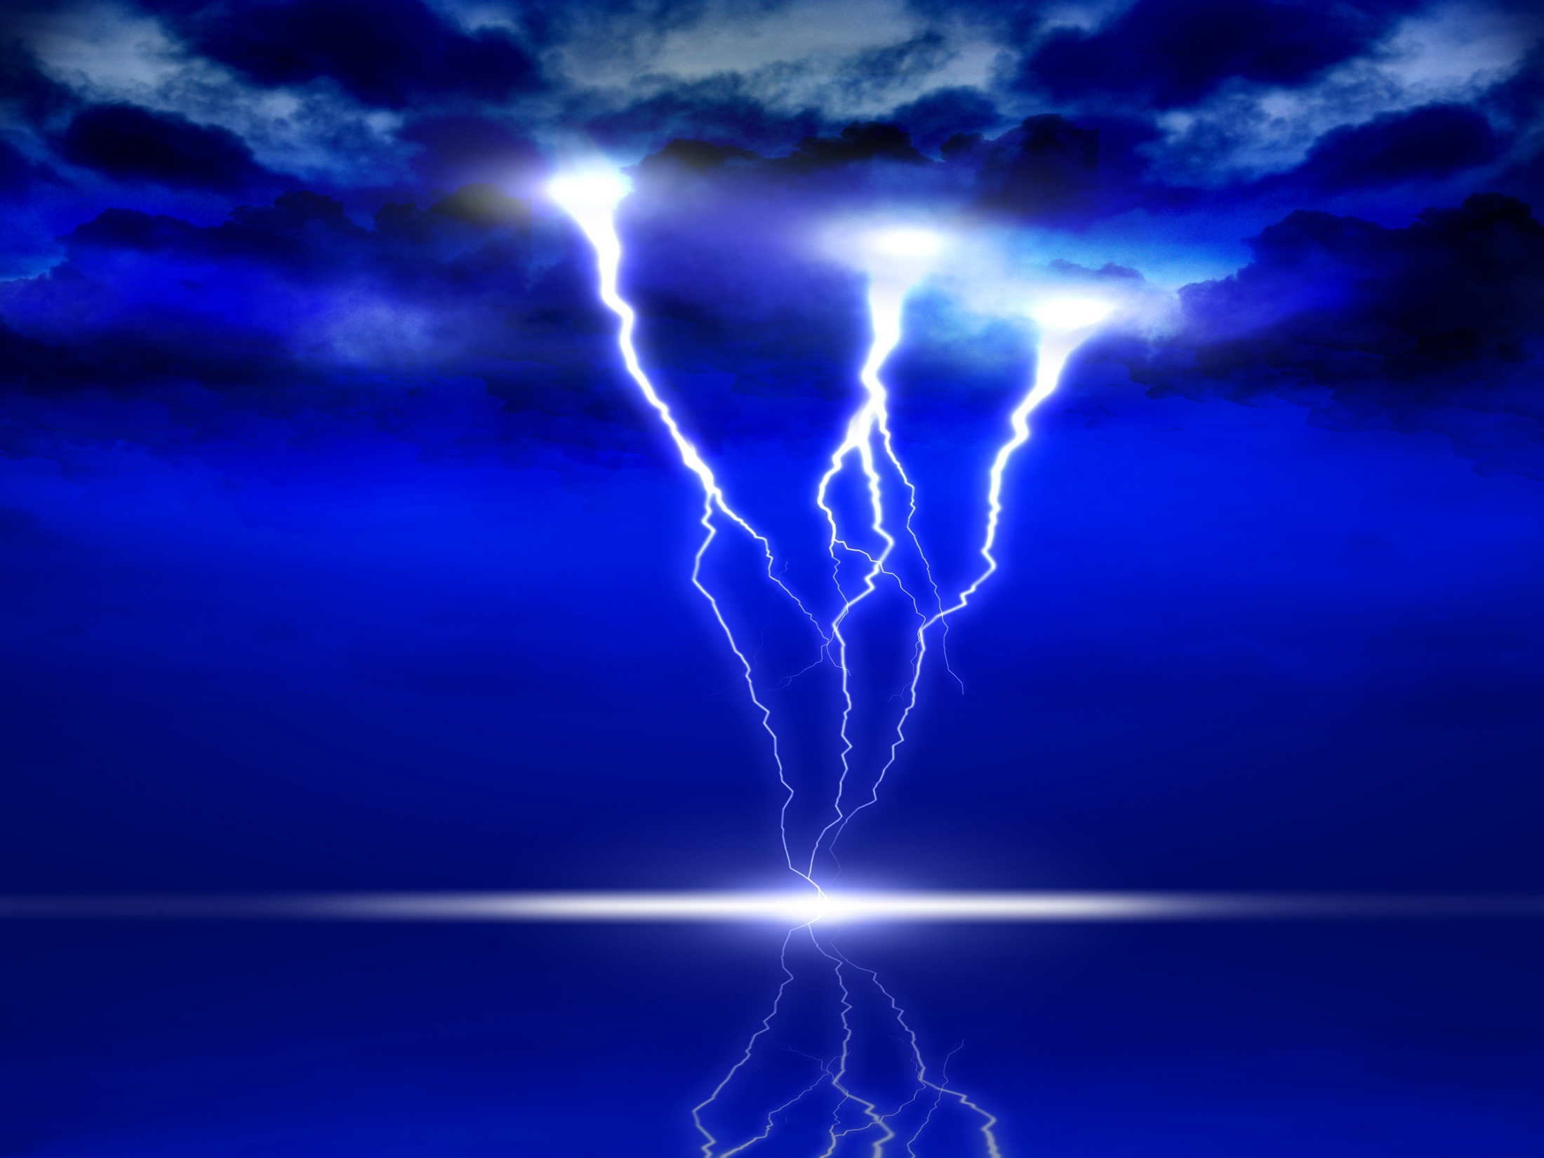
We Care
So to get in to the saving gospel and avoid destruction, what does God say
I must do?
II Thessalonians 1:7-9 (pg. 312)
7 and to give you who are troubled rest with us when the Lord Jesus is revealed from heaven with His mighty angels, 8 in flaming fire taking vengeance on those who do not know God, and on those who do not obey the gospel of our Lord Jesus Christ. 9 These shall be punished with everlasting destruction from the presence of the Lord and
from the glory of His power,

Slide 32

We Care
If God says we must “obey the gospel” to be saved, then……
How am I supposed to obey the gospel?

Slide 33
We Care
Romans 6:3-6 (pg. 235)
3 Or do you not know that as many of us as were baptized into Christ Jesus were baptized into His death? 4 Therefore we were buried with Him through baptism into death, that just as Christ was raised from the dead by the glory of the Father, even so we also should walk in newness of life. 5 For if we have been united together in the likeness of His death, certainly we also shall be in the likeness of His resurrection, 6 knowing this, that our old man was crucified with Him, that the body of sin might be done away with, that we should no longer be slaves of sin.

Slide 34
We Care
Romans 6:17-18 (pg. 236)
17 But God be thanked that though you were slaves of sin, yet you obeyed from the heart that form of doctrine to which you were delivered. 18 And having been set free from sin, you became slaves of righteousness.

Slide 35

We Care
Died
Raised
The gospel re-enacted at baptism - how we get into Jesus death!
Romans 6:3-6
Buried

Slide 36

We Care
Galatians 3:26-27 (pg. 287)
26 For you are all sons of God through faith in Christ Jesus. 27 For as many of you as were baptized into Christ have put on Christ.

Slide 37

We Care
If you choose to be buried with Christ – it won’t always be easy. Satan will do all he can to alter your path!

Slide 38
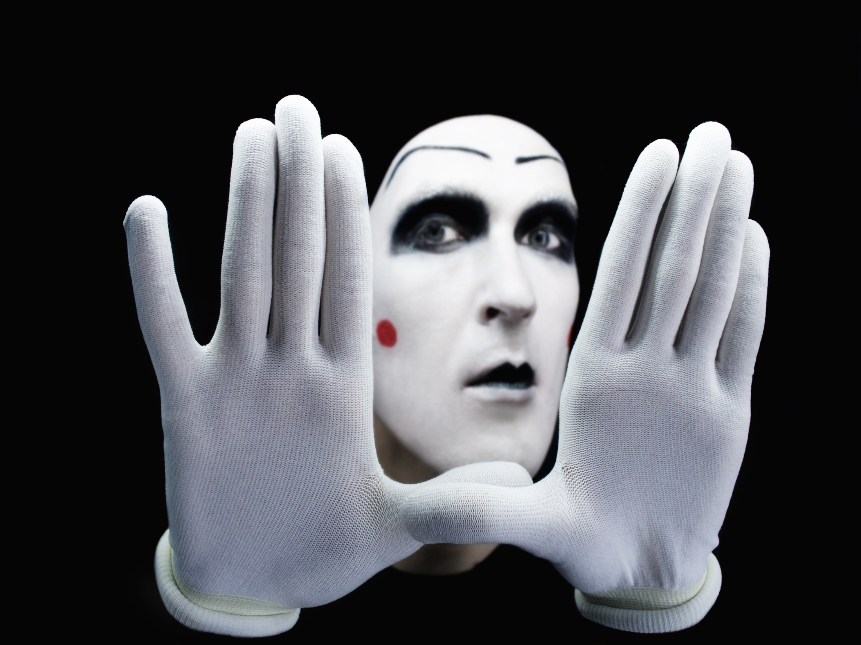
We Care
John 15:20 (pg. 167)
20 Remember the word that I said to you, 'A servant is not greater than his master.' If they persecuted Me, they will also persecute you. If they kept My word, they will keep yours also.

Slide 39

We Care
Matthew 10:34-38 (pg. 15)
34 "Do not think that I came to bring peace on earth. I did not come to bring peace but a sword. 35 For I have come to 'set a man against his father, a daughter against her mother, and a daughter-in-law against her mother-in-law'; 36 and 'a man's enemies will be those of his own household.' 37 He who loves father or mother more than Me is not worthy of Me. And he who loves son or daughter more than Me is not worthy of Me. 38 And he who does not take his cross and follow after Me is not worthy of Me.

Slide 40
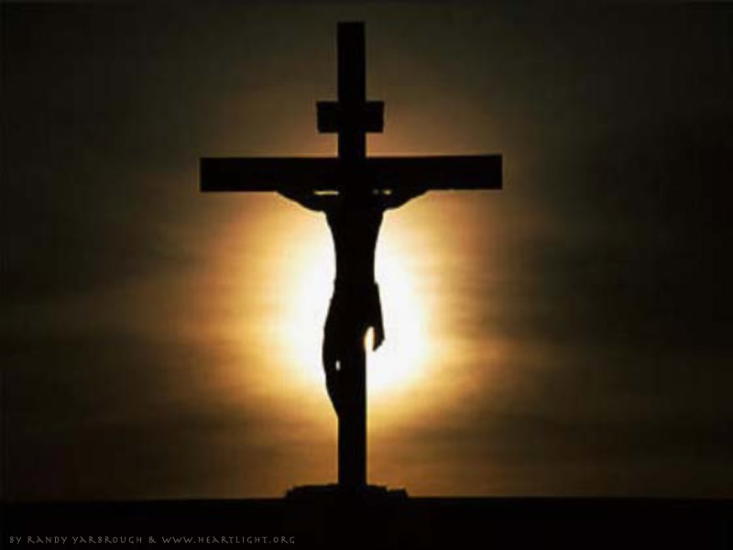
We Care
Luke 14:26-28 (pg. 116)
26 "If anyone comes to Me and does not hate his father and mother, wife and children, brothers and sisters, yes, and his own life also, he cannot be My disciple. 27 And whoever does not bear his cross and come after Me cannot be My disciple. 28 For which of you, intending to build a tower, does not sit down first and count the cost, whether he has enough to finish it--

Slide 41
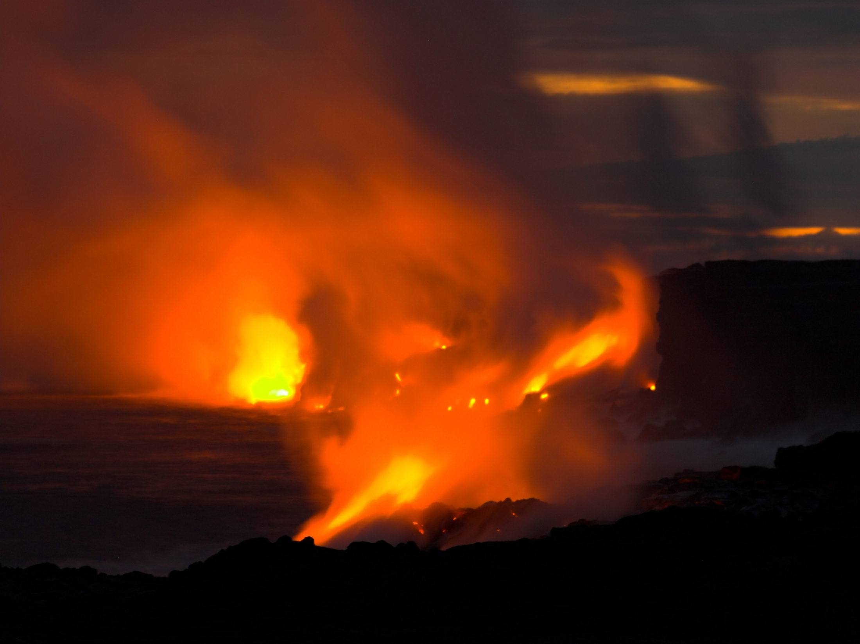
We Care
Jesus commands commitment!
II Peter 2:20-21(pg. 356)
20 For if, after they have escaped the pollutions of the world through the knowledge of the Lord and Savior Jesus Christ, they are again entangled in them and overcome, the latter end is worse for them than the beginning. 21 For it would have been better for them not to have known the way of righteousness, than having known it, to turn from the holy commandment delivered to them.

Slide 42

We Care
God
The Gospel of Jesus Christ
No greater love has ever been
Sin
Death

Slide 43
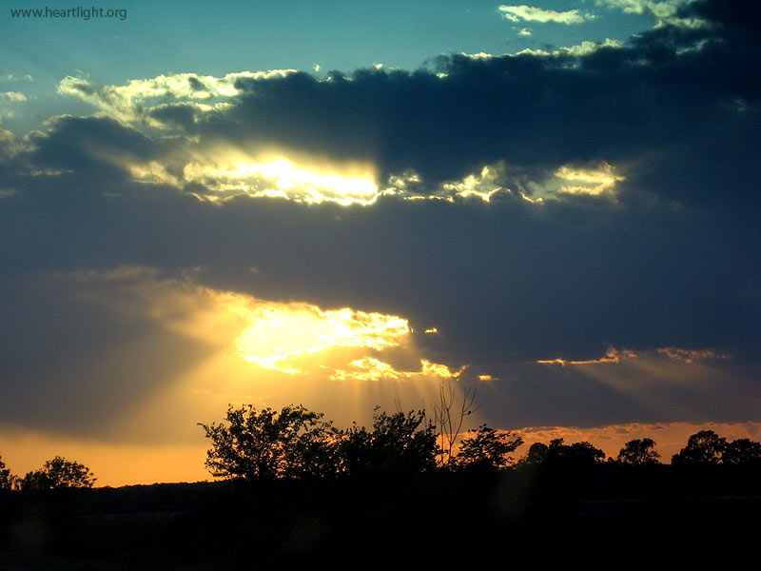
Acts 22:16 (pg. 217)
16 And now why are you waiting? Arise and be baptized, and wash away your sins, calling on the name of the Lord.'

